Slide 1
Unit 5 Image Compression and Coding
Hours:[7 hrs]
Presented By
Er.Harendra Bikram Shah
(Lecturer)
Department of Computer Engineering

Slide 2
OUTLINES
5.1 Need of Compression
5.2 Lossy & Lossless Compression, Issues of Compression
5.3 A generic model of compression
5.4 Element of Information Theory (Self Information, Entropy)
5.5 Data Redundancy, Coding Redundancy
5.6 Types of compression techniques
5.6.1 Entropy Encoding
5.6.1.1 Run Length Encoding (Interpixel Redundancy)
5.6.1.2 Huffman Encoding (Coding Redundancy)
5.6.1.3 LZW coding
5.6.2 Transform Coding
5.6.2.3 Predictive Coding

Slide 3
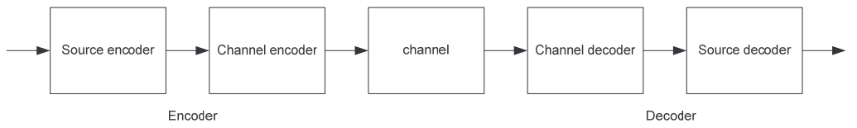
Introduction to Image Compression
process of reducing the size of an image file while retaining as much visual quality as possible.
This is important for efficient storage, transmission, and processing of images.
There are two main types of image compression: lossless and lossy.
Applications of Image Compression:
Medical Imaging:
Video Conferencing:
Satellite imagery:
Social Media:
Digital Photography:

Slide 4
Need of Image Compression
1. Storage Efficiency
2. Transmission Speed
3. Cost Reduction
4. Performance Improvement
5. Compatibility
Issues in Image Compression
1. Loss of Quality (in Lossy Compression)
2. Complexity
3. Trade-Off Between Quality and Compression Ratio
4. Standard Compatibility
5. Error Sensitivity

Slide 5
Element of Information Theory (Self Information, Entropy)
founded by Claude Shannon, provides the mathematical foundation for data compression.
1. Self Information (Surprisal)
Self-information quantifies the amount of information (or surprise) associated with an event occurring.
For a symbol (like a pixel value) with probability p(x), the self-information is:
I(x) = −log2​(p(x))
➤ Interpretation in Image Compression:
Rare pixel values (low probability) contain more information (are more surprising).
Common pixel values (high probability) carry less information.
➤ Example:
If a pixel value appears with probability 1/2, its self-information is:
I(x) = −log2(1/2) = 1 bit
If another pixel value appears with probability 1/8:
I(x)= −log2(1/8) =3 bits
So, rarer values need more bits to encode.

Slide 6
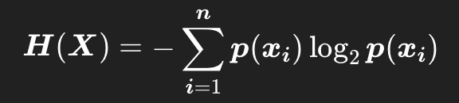
Element of Information Theory (Self Information, Entropy)
2. Entropy (Average Information)
Entropy is the average self-information of all possible symbols (pixel values) in the image.
It represents the lower bound on the number of bits needed per symbol (on average) for optimal lossless encoding.
Where:
p(xi): probability of symbol xi
H(X): entropy of the source
Role in Image Compression:
Lower entropy means the image is more compressible.
Higher entropy means the image is more complex and harder to compress.
Entropy helps determine how much redundancy is in the image data.

Slide 7
Redundancies in Image Compression
Spatial Redundancy/Inter-Pixel Redundancy/Intraframe Coding:
refers to similarities or patterns in pixel values within the same image.
Compression techniques Used are Run-Length Encoding (RLE) or predictive coding.
Temporal Redundancy/Interframe Coding(in Video Compression):
occurs when consecutive frames in a video sequence share similarities.
Compression Technique: inter-frame prediction and motion compensation.
Color Redundancy:
arises when there are correlations among Color components in an image.
Compression Technique: Color space transformations and chroma subsampling(Less resolution Technique)
Psychovisual Redundancy:
based on the limitations of the human visual system.
Compression Technique: JPEG compression.
Statistical Redundancy:
related to the probability distribution of pixel values in an image.
Compression Technique: Huffman coding
Transform Redundancy:
arises when there are correlations in the spatial domain that can be better represented in a transformed domain.
Compression Technique: JPEG compression

Slide 8

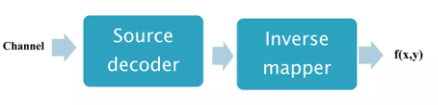
Generic Model of Image Compression

Slide 9
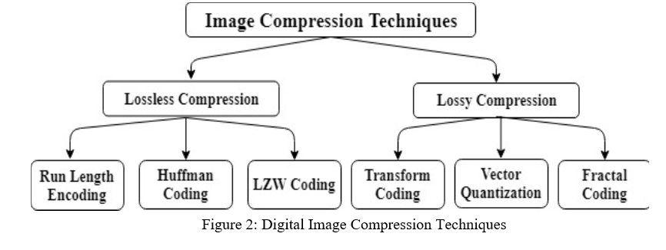

Slide 10
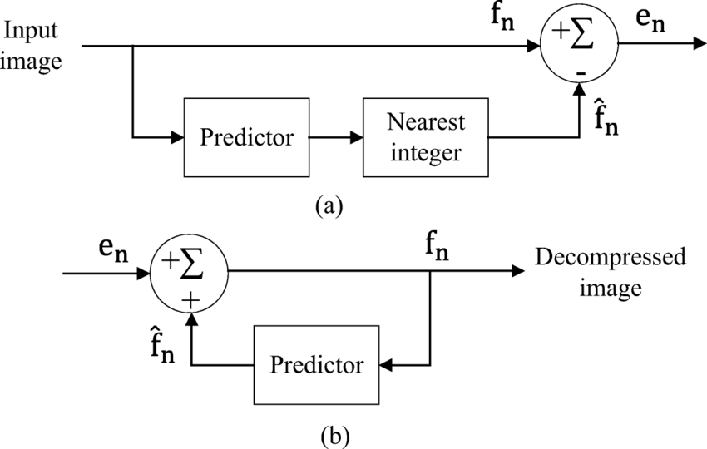
Lossless Predictive Coding /Lossless Compression
Symbol Encoder
Compressed
Image
Compressed
Image
Symbol Decoder

Slide 11
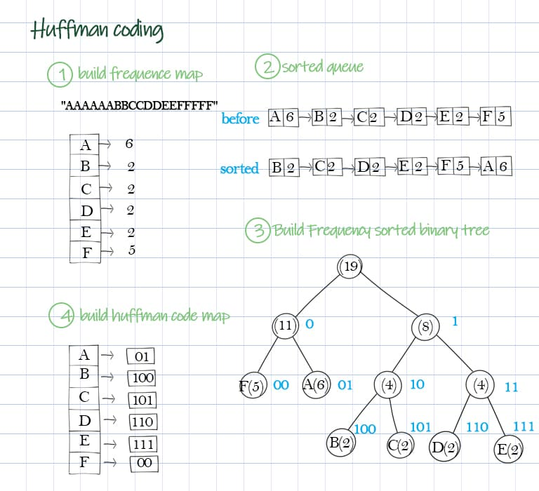
HUFFMAN Coding

Slide 12
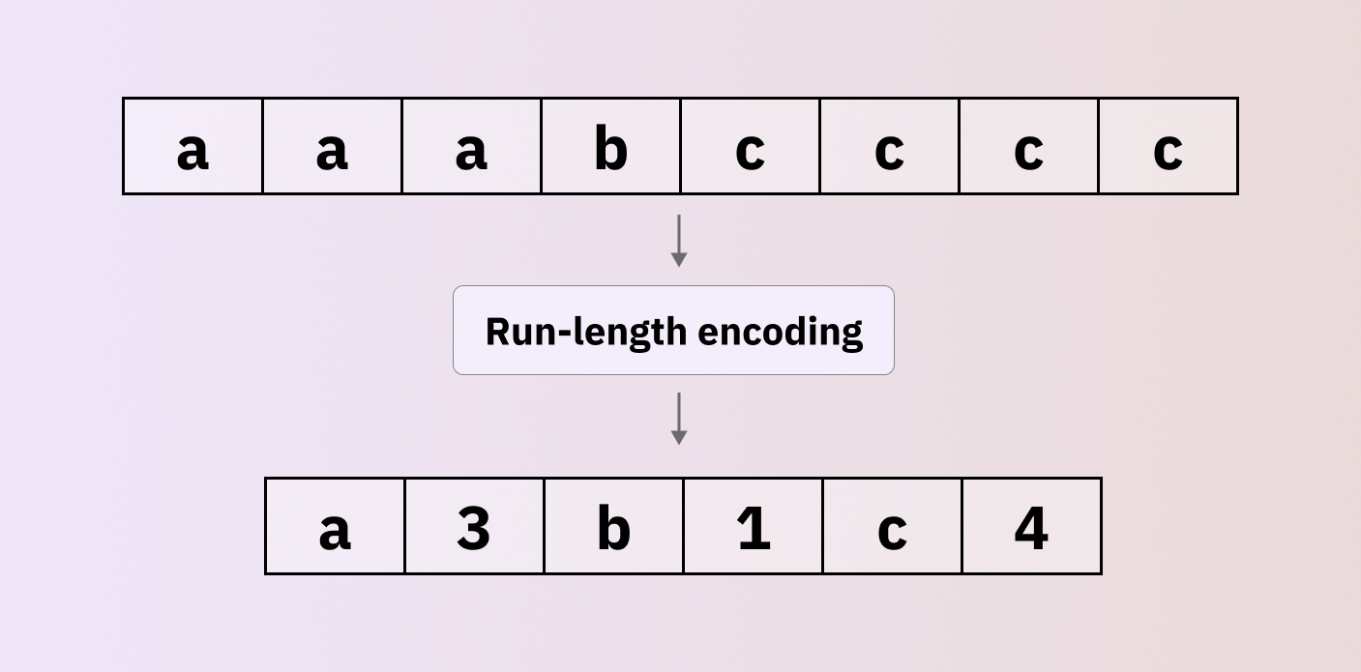

Slide 13

LZW[Lempel–Ziv–Welch] CODING

Slide 14
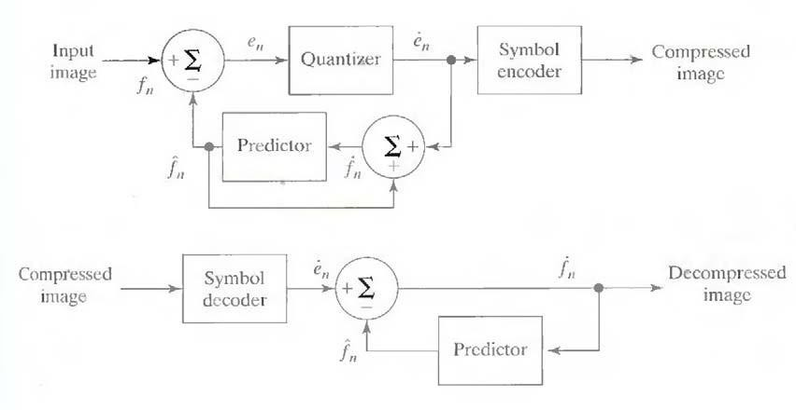
Lossy Predictive Coding/Lossy Image Compression

Slide 15
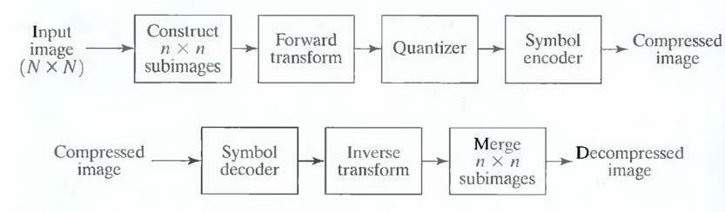
Transform Coding

Slide 16
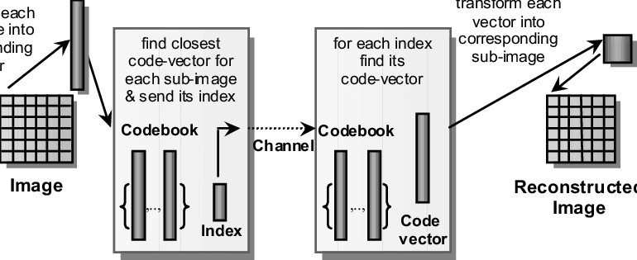
Vector Quantization

Slide 17
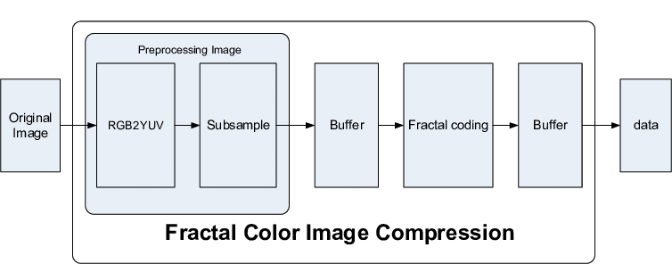
Fractal Coding

Slide 18
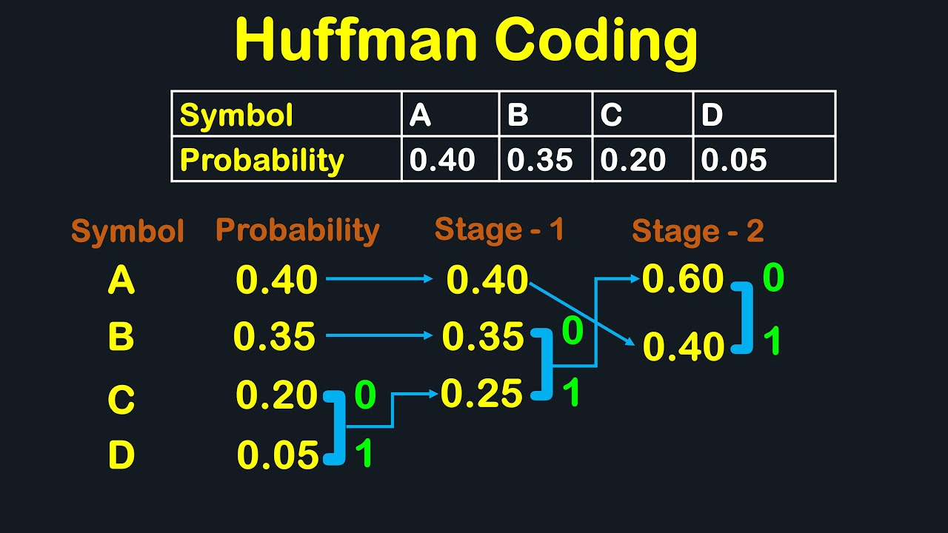
Numerical of Huffman Coding

Slide 19
End of UNIT 5

Slide 20
THANK YOU

